Slide 1

Welcome to the Climbing Club!

Slide 2
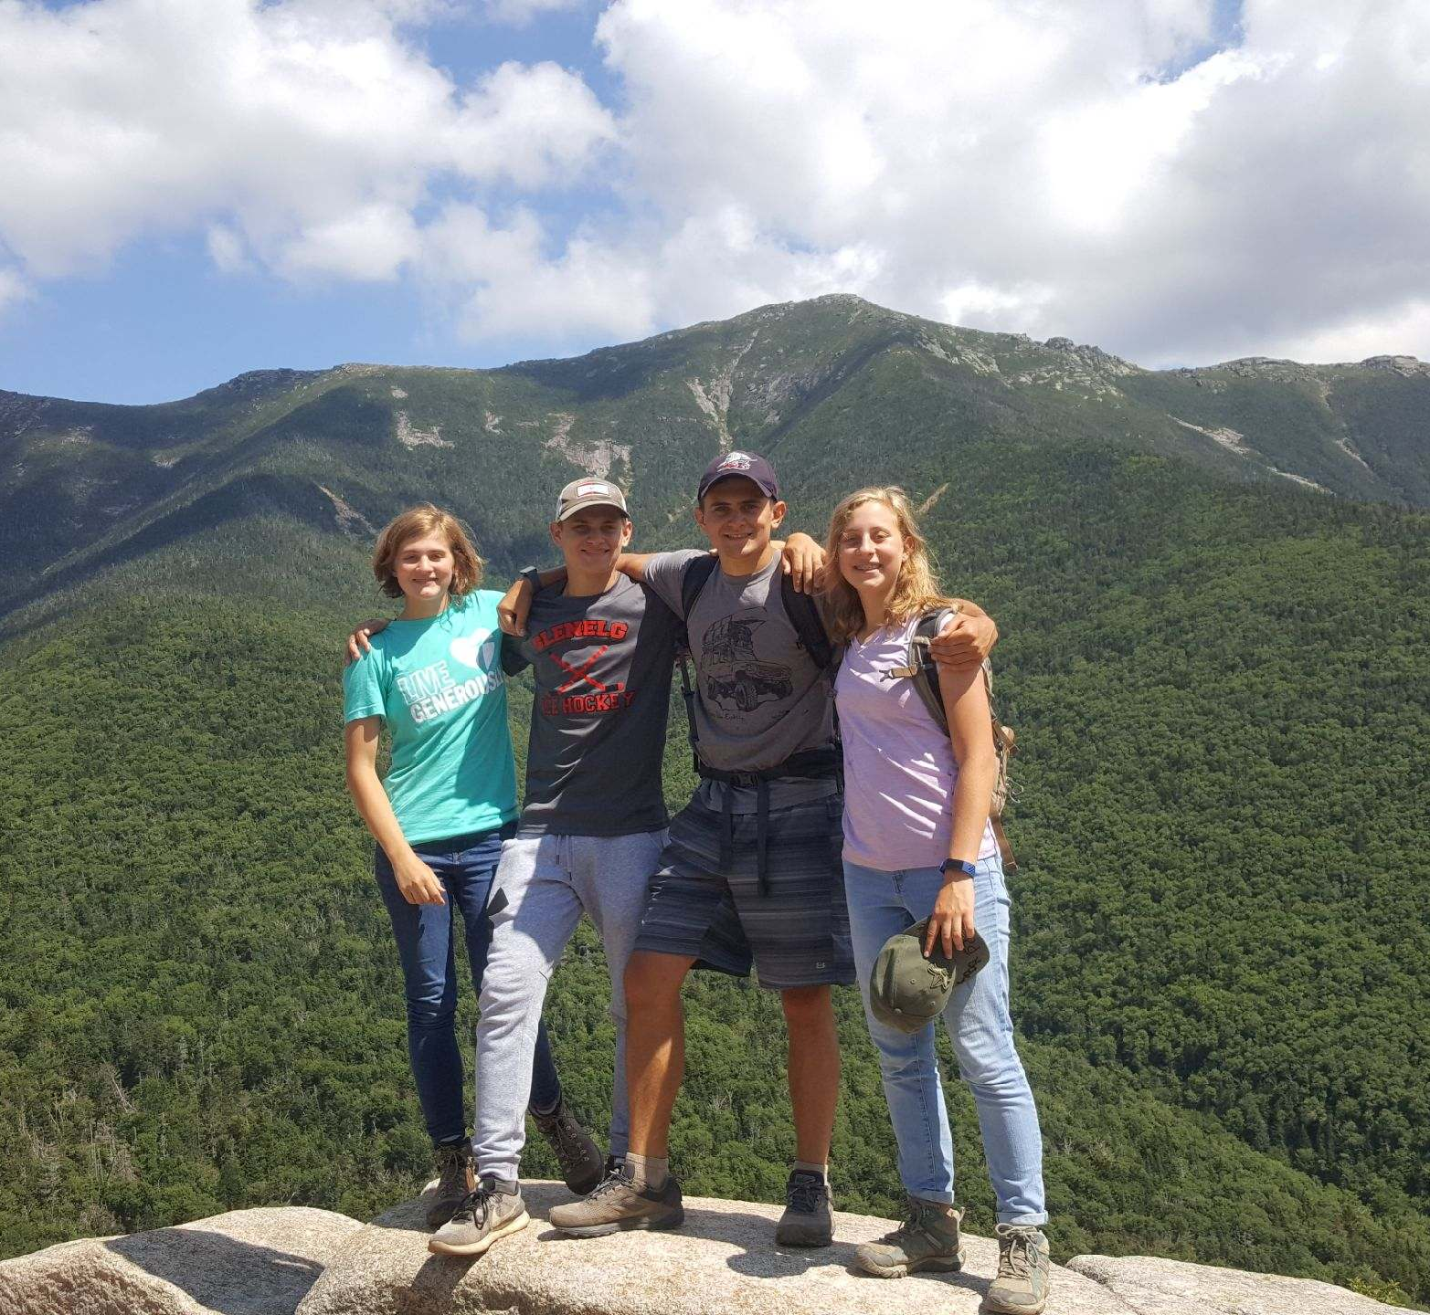
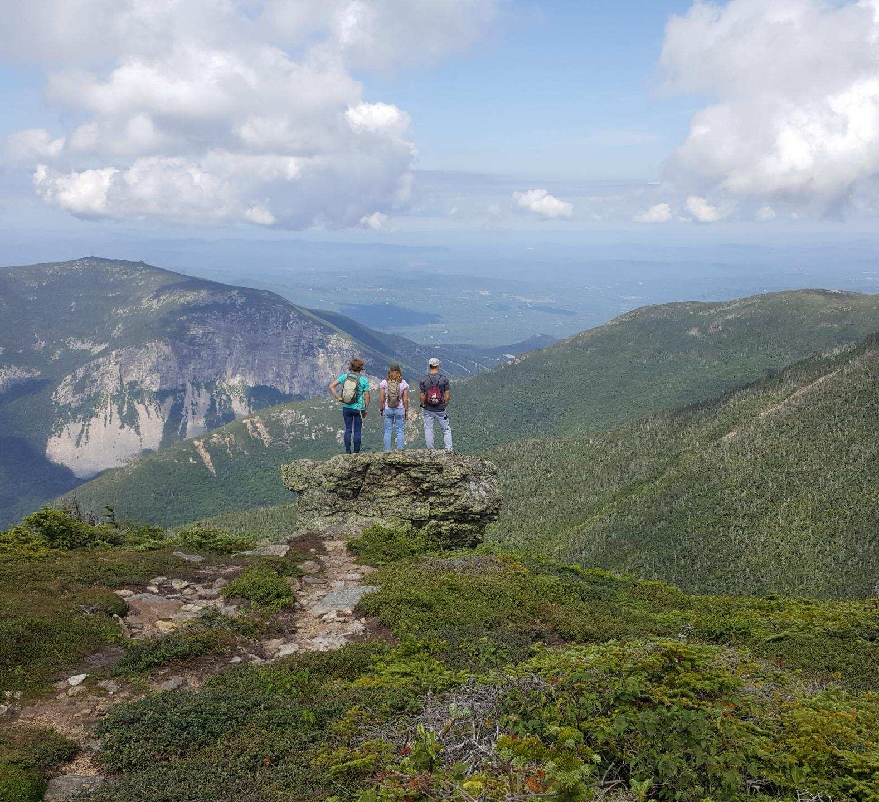
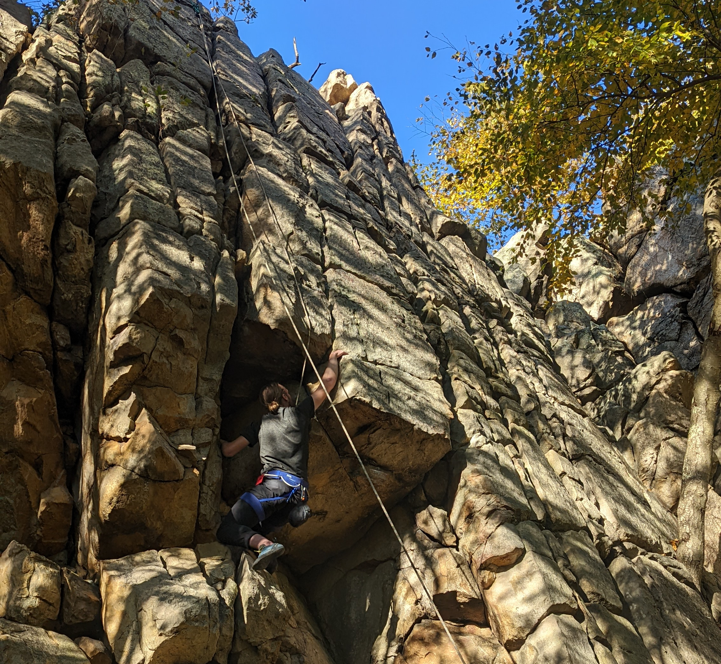
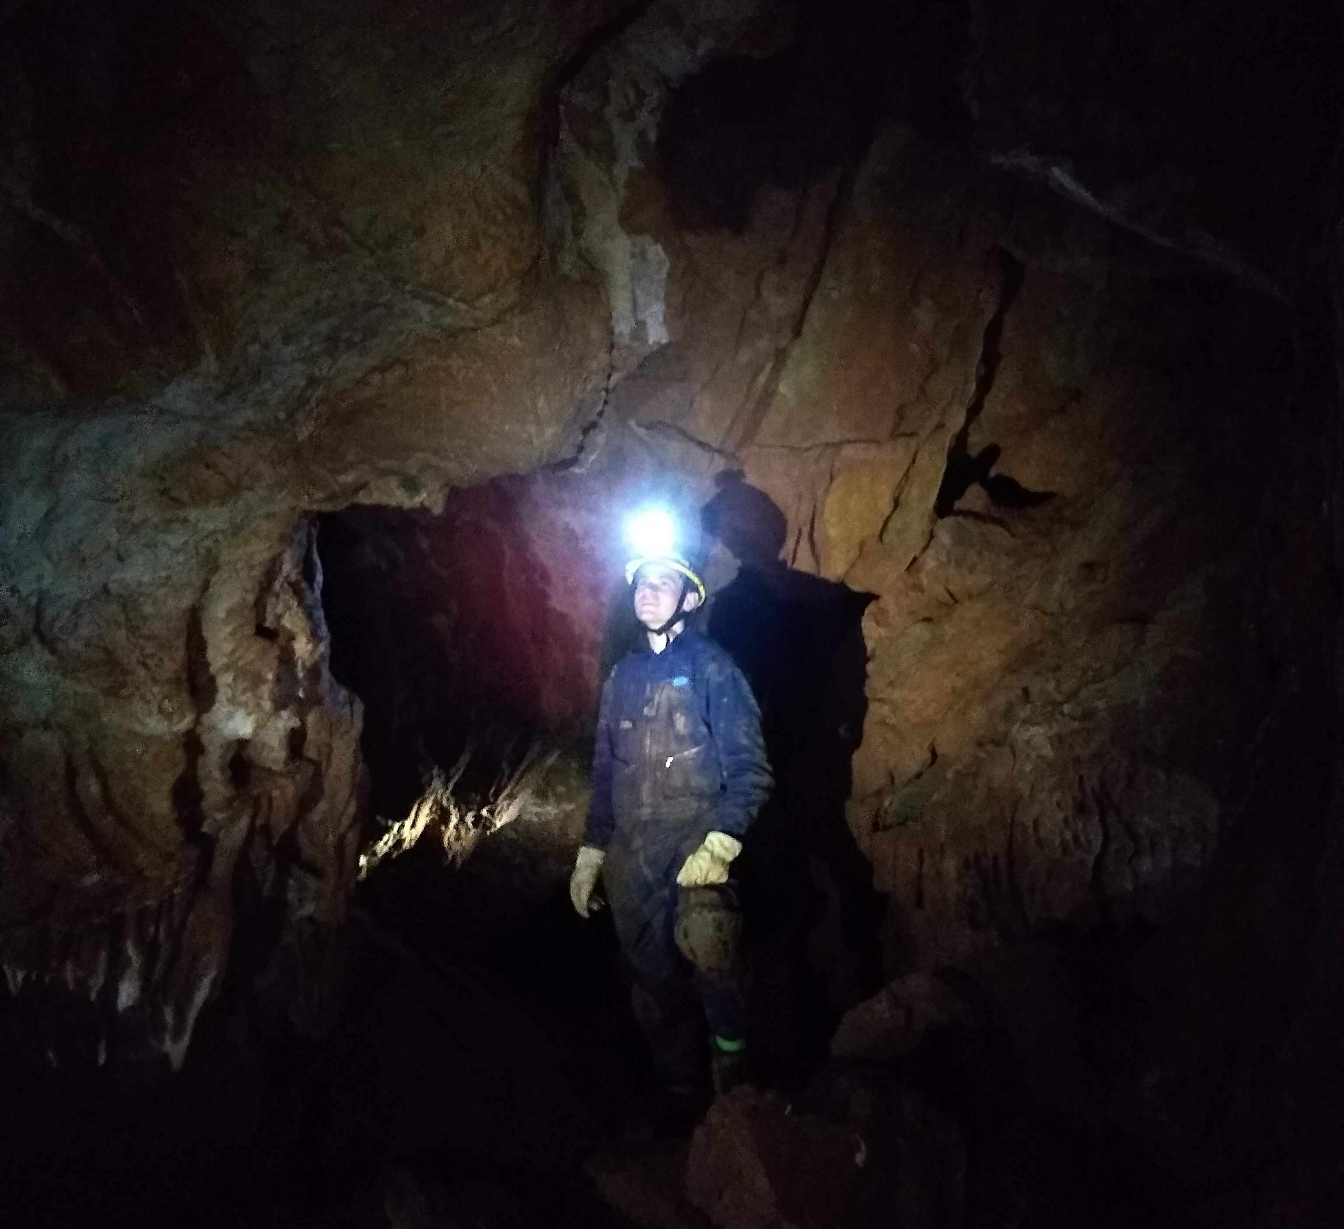
About me
Tommy Rohmann, Senior
USCG Unlimited Engine License, B.E. Naval Architecture
I like to climb, ski, hike, build stuff, etc.

Slide 3
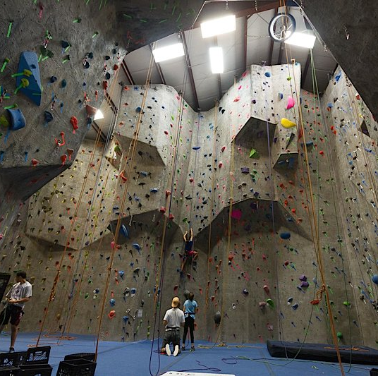
The Rock Club
Climbing at the Rock Club in New Rochelle. We pre-pay day passes so you can go M/W/F.
To get the ball rolling on this, we have members pre-pay $36 (the price of 2 day passes) while we wait for funding to come in from SGA and other sources
In the past we coordinated classes there, though this might require more funding if someone is willing to work for this.

Slide 4
Plans for the Semester
I am involved with a lot of stuff on campus. My only goal for the next semester is to keep our previous club activities from last year going (day passes with the Rock Club).
If anyone wants to go further with the club, or help to run it and plan additional events, please feel free to run for a position.

Slide 5
How we can go further with the club
Trips to other places, including out-door climbing (Powerlinez, the Gunks for bouldering, top rope, and sport climbing)
Club Merch
Our advisor, Thomas Callahan, enjoys climbing, and has several suggestions for the club.

Slide 6
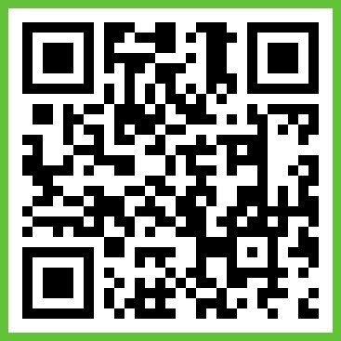
Join the BAND

Slide 7
Thanks for coming!

